Slide 1


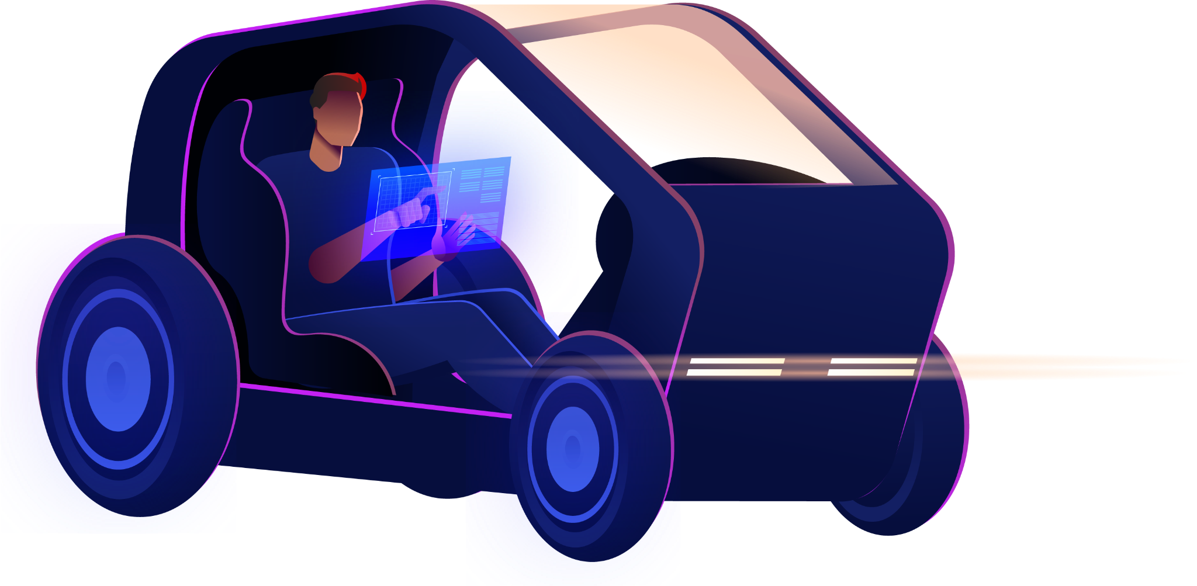


Ride Go Share the Smart way with Ride Go!!

Slide 2
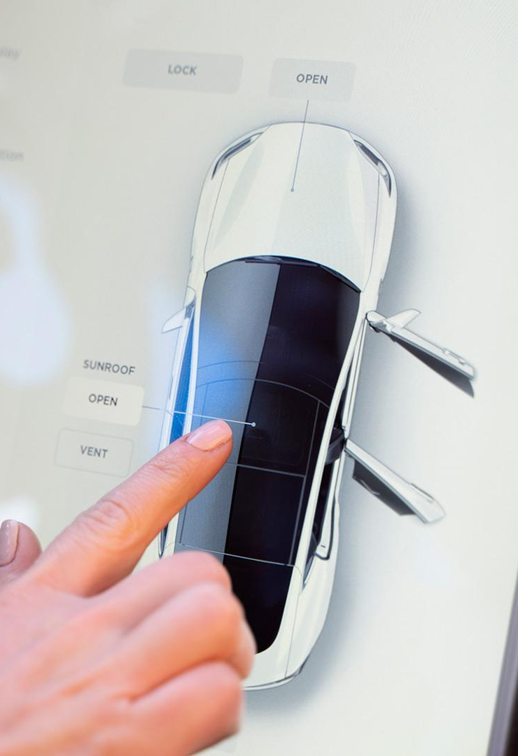

Who are we?
Welcome to RideGo, the future of sustainable and affordable commuting! The innovative platform linking drivers and commuters in the ultimate win-win scenario.
Whether you’re heading to work, meeting friends, or exploring the city, Ride Go makes your journey smooth and convenient.
Our app provides reliable transportation options tailored to your needs, ensuring you reach your destination comfortably and on time.
At Ride Go, we strive for mutual benefits, because when our drivers and riders win, so do we.

Slide 3



01
Vision

Slide 4
Vision Board
Vision: To create an app that revolutionizes commuting between towns by providing a user-friendly platform for car owners and travellers to easily connect, book rides, and enhance the overall transportation experience.
Target Group: The target group for the app can be divided into two main categories: car owners willing to drive and offer rides to travellers and travellers whoneed transportation between towns. The app would provide a platform for these two groups to connect and coordinate their rides effectively. | Needs: This app solves the problem of inefficient and unorganized commuting between towns by connecting car owners and travellers, making it easier to book rides and coordinate transportation. | Product: The product is a mobile app that serves as a platform for car owners and travellers to connect and coordinate rides between towns. What makes this product stand out is its user- friendly interface, efficient matching algorithm, and the convenience it offers by streamlining the process of booking rides and managing schedules. | Business Goals: The company’s business goal behind this product is to create a successful platform that facilitates convenient and organized ridesharing between car owners and travellers. A reliable and user-friendly app will help generate revenue through advertising and transaction fees while attracting a large user base. The product benefits the company by driving user engagement, increasing customer satisfaction, and potentially attracting partnerships with other businesses in the transportation industrv.

Slide 5
Market size overview
$110m
Include the total size of the market, which represents the entire potential customer base for the product or service
$25m
Identify the target market for the product or service, which may be a subset of the total market. This could be based on factors such as demographics, geography, or specific needs
$6m
Indicate the current market size, which represents the portion of the target market that the company has successfully captured

Slide 6
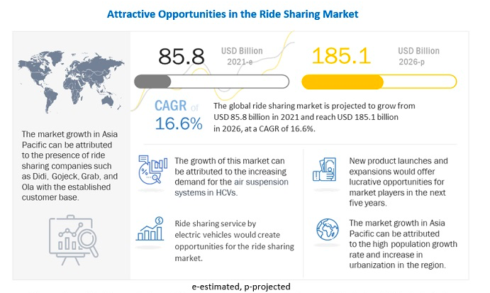
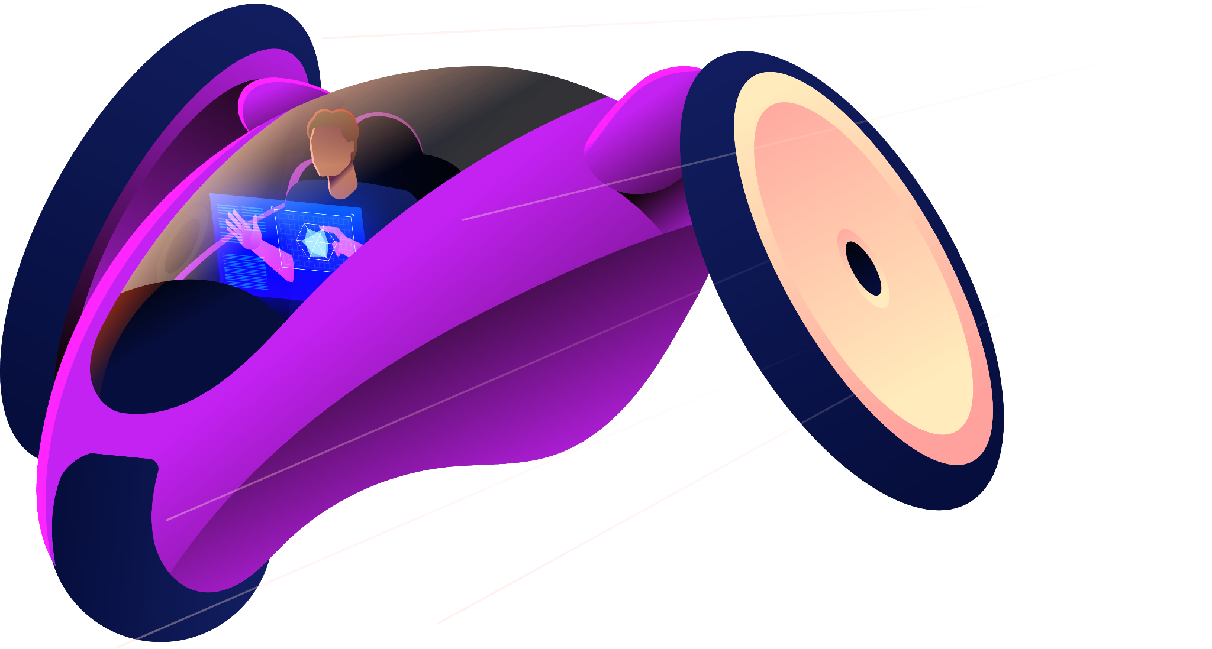


Slide 7
02
Competitive Analysis

Slide 8
Uber
Lyft
Market Presence: Operates primarily in all over the world, where it is the leading ride-sharing service.
User Base: Has a large user base around the world has expanded its services to include food delivery and other offerings.
Pricing and Fees: Offers competitive pricing and various promotions to attract users.
Service Offerings: Generally perceived positively, with a reputation for being a reliable and convenient transportation.
Market Presence: Operates primarily in the United States and Canada, with a growing presence in other countries.
User Base: Has a significant user base, especially in North America, and is known for its focus on customer service.
Pricing and Fees: Offers competitive pricing similar to Uber, with occasional promotions and discounts.
Service Offerings: Provides various ride options, including standard rides (Lyft), shared rides (Lyft Shared), and luxury rides (Lyft Lux).

Slide 9
How Ride Go is different?
Ride Go offers a unique model in the crowded space of ride-hailing services.
While most services rely on professional drivers, Ride Go connects commuters directly with regular car owners.
This model benefits riders with potentially cheaper rates, and benefits drivers by offering a flexible way to earn extra money.
The focus on community-building and promoting an eco-friendlier alternative to commuting set Ride Go apart from many competitors.
The Ride Go model essentially introduces a peer-to-peer platform for commuting, transforming personal cars into an exciting new form of public transportation.

Slide 10
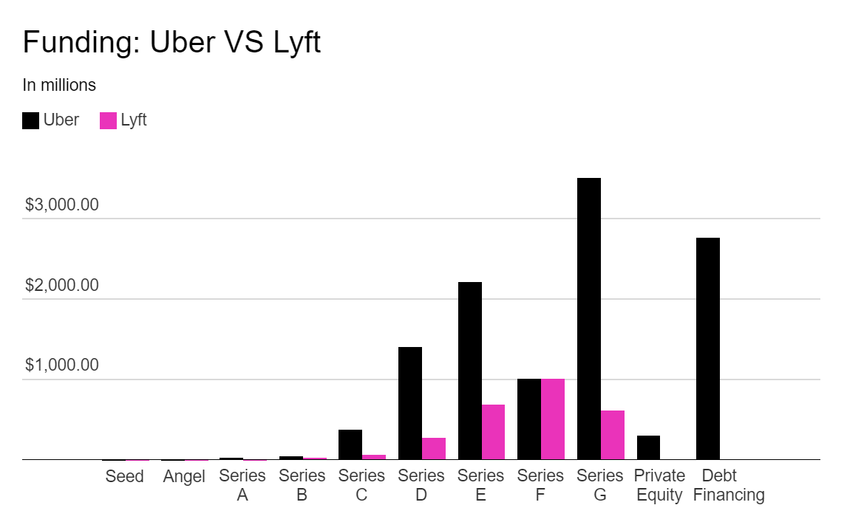
Funding Analysis
Source: Crunchbase

Slide 11
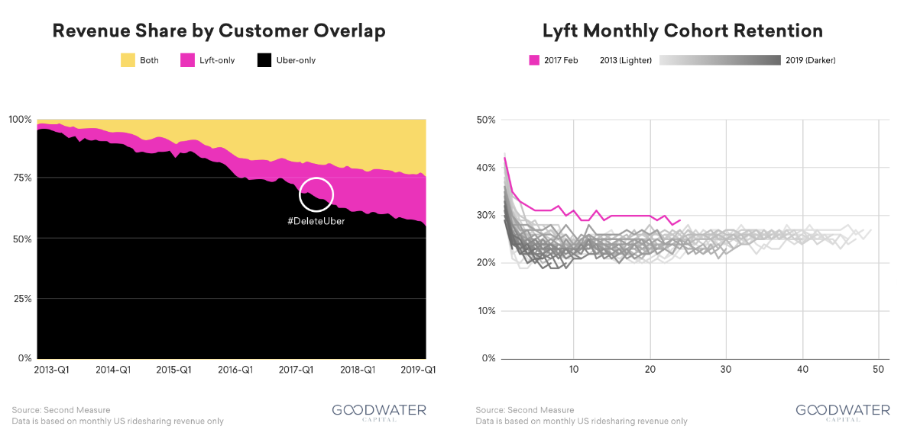

Slide 12
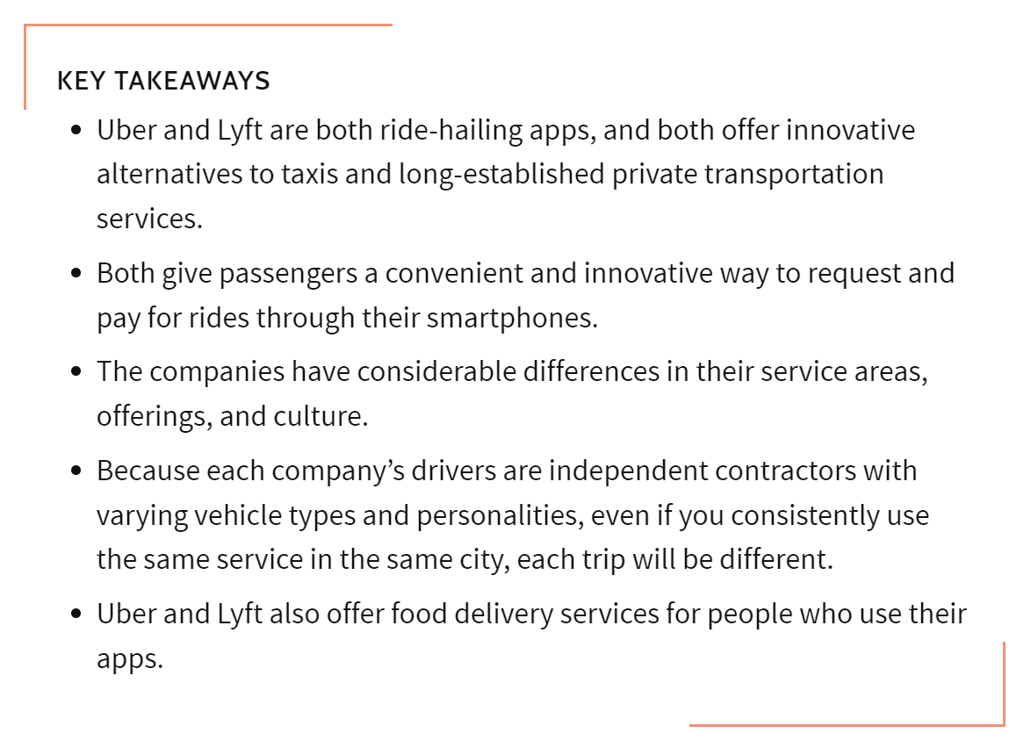
Key Takeaways (Uber, Lyft)

Slide 13
03
User Stories

Slide 14

Sarah: The Commuter
Back Ground information.
Sarah is a 28-year-old marketing executive who commutes to work daily and prefers shared rides for her daily commute due to environmental concerns and to save costs. She is tech-savvy and prefers using convenient and user-friendly apps on her smartphone.
As a regular commuter, I want an affordable daily ride option, So that I can save on my commuting costs and lessen my carbon footprint.

Slide 15
David: The Car Owner
David is a 35-year-old professional living in Kitchener, Ontario. He works as a sales representative and often travels to nearby towns for client
meetings.
David wants to supplement his income by offering rides to travelers during his
commute to work. He values flexibility and wants to manage his availability and schedule rides according to his convenience.
David finds it challenging to find passengers for his rides, as there's no centralized
platform for connecting with traveler. He worries about safety and reliability when offering rides to strangers.
David is a new age man and comfortable using mobile apps for various purposes. He values transparency and appreciates platforms that provide clear information about users and their ratings.

Slide 16
Rachel: The Safety-Conscious Passenger
She works as a project manager in a tech company and commutes from the suburbs to the city for work daily.
Rachel is a 22-year-old college student who often travels across town for classes. She values safety and transparency when using any ride-sharing app.
As a safety-conscious passenger, I want to know that the drivers are verified and the cars are reliable, So that I feel safe while using the Ride Go service.
One of the challenges Rachel faces is the lack of a convenient platform and Safety while commuting that connects her directly with car owners heading in her direction and feels safe. She also has concerns about safety and comfort when sharing rides with strangers.

Slide 17


40,000 in KWC
Number of users analyzed in our market research

Slide 18
Product Roadmap
01
02
03
04
05
06
07
08
Outline the product's purpose, target audience, and goals.
Gather information on competitors, industry trends, and customer needs.
Identify the customer's pain points
and challenges
Create a list of features and functionalities based on the research.
Highlight the unique value proposition and benefits of your specific solution
Develop a timeline with milestones and deadlines for each feature.
Build a prototype or minimum viable product (MVP) to validate the concept.
Gather feedback from users and stakeholders, and iterate on the product based on feedback.

Slide 19
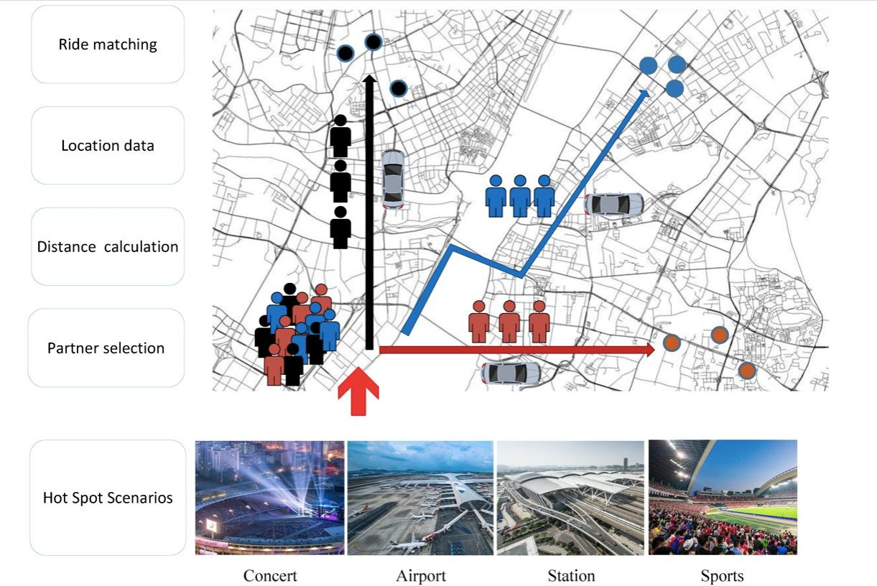
Probable Working Model of Ride Go

Slide 20
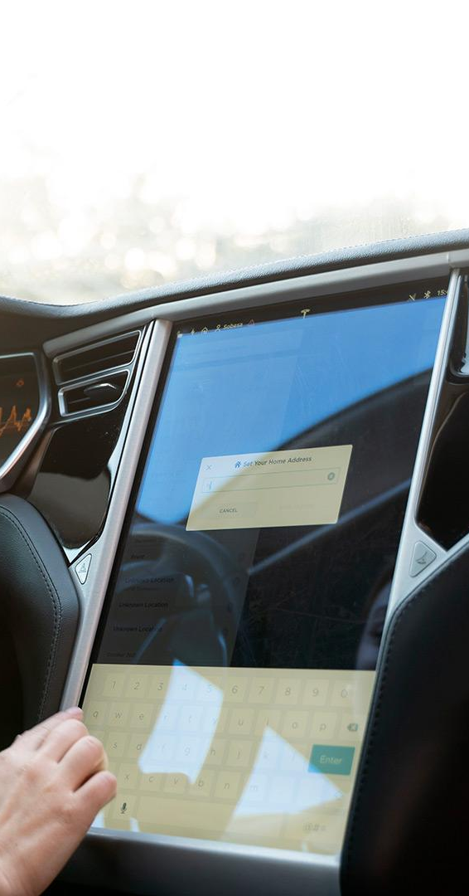
Product infographic
Visuals
Features
An interactive app for multi platform
Driver Log-In
Commuter Log-In
Price
Users
Car owners, Daily Commuters
Lowest prices compared to others
Availability
Updates
24/7 at Most of the places
Based on Feedback of users

Slide 21
Competition comparison
 | Features | Value | Pricing | Trial | Competence | Share
Uber | Fuel economy | Special offers | $23,000 | No | Low | 8%
Lyft | Design | Reliability | $27,000 | No | Low | 5%
Lokal | Performance | Repairs | $30,000 | Yes | High | 20%
Didi | Safety features | Marketing | $24,000 | No | High | 22%
Popa Ride | Technology | Customers | $32,000 | Yes | Low | 10%

Slide 22
04
Product Backlog & Sprints

Slide 23
Product Backlog Item Breakdown
Workflow Steps: The user requests a ride. The system identifies available taxis. The user confirms the ride. The taxi arrives at the user's location. The user completes the ride. | Business Rules: Ride requests must include a valid pickup location. Only registered users can request rides. Payment must be confirmed before the ride starts.
Happy / Unhappy Flow: Happy Flow: The user requests a ride, confirms, and completes it successfully. Unhappy Flow: The user requests a ride but doesn't confirm, or the taxi doesn't arrive on time. | Input Options: Supported platforms: Mobile app (iOS, Android), Web app. All platforms are required for the initial launch.
Data Types and Parameters: Data types: Location (latitude, longitude), User ID, Taxi ID, Ride Status. Parameters: Pickup time, Drop-off time, Fare, Distance. | Operations: CRUD operations for rides: Create (request ride), Read (view ride details), Update (cancel ride), Delete (remove ride record).
Test Cases: Test scenarios: Valid ride request, Invalid ride request, Cancel ride, View ride history. All test scenarios are relevant for ensuring system functionality. | Roles: User roles: Customer (request and complete rides), Administrator (manage rides and user accounts). All roles are necessary for managing the ride service.
Browser Compatibility: Supported browsers: Chrome, Safari, Firefox, Edge. Compatibility with older browsers can be considered later based on user data. | Optimize Now vs Optimize Later: Optimize Now: Implement GPS location for accurate ride tracking and a user-friendly interface for easy ride requests. Optimize Later: Implement autocomplete for addresses and refine search algorithms for faster taxi allocation.

Slide 24
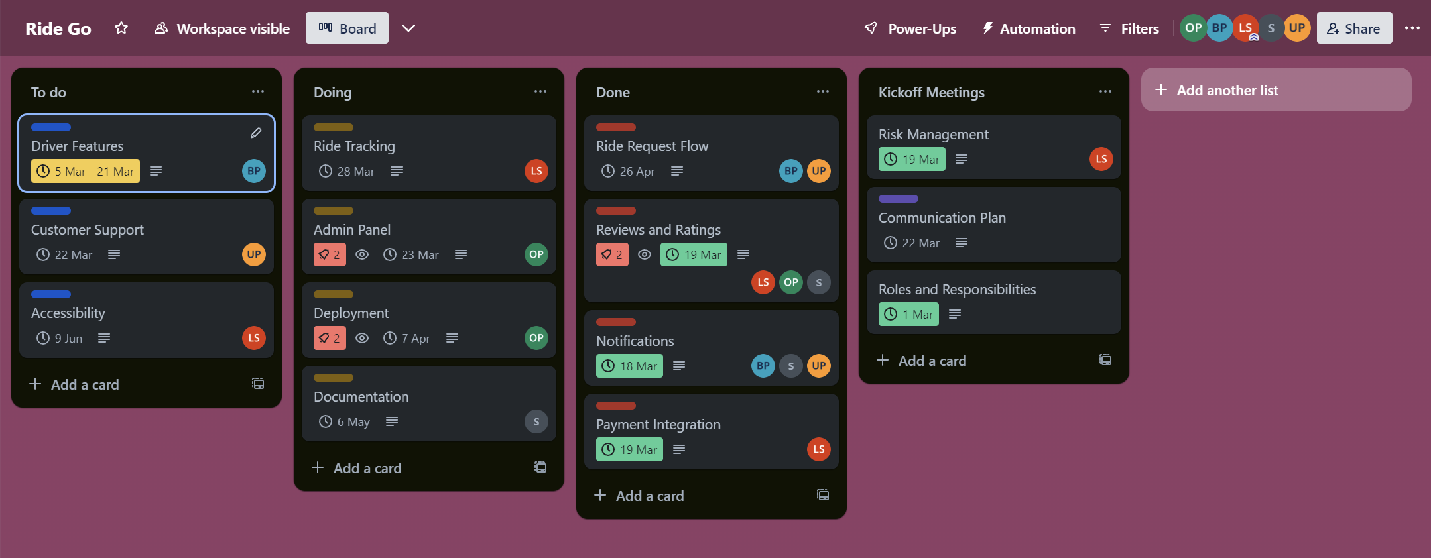
Product Backlog Item

Slide 25
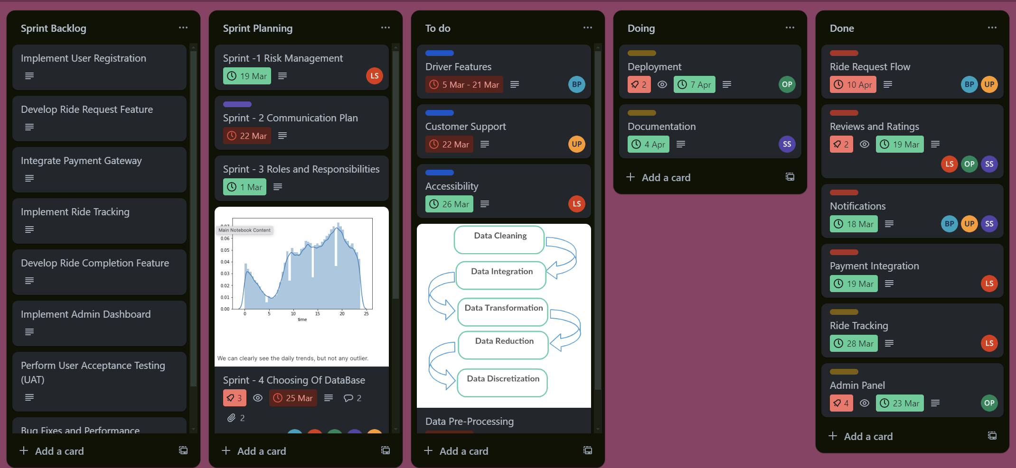
Link : https://trello.com/invite/b/dTuFdbkR/ATTI551aef339d7fe29bdc9707ba3f5b838b705AFD12/ride-go

Slide 26
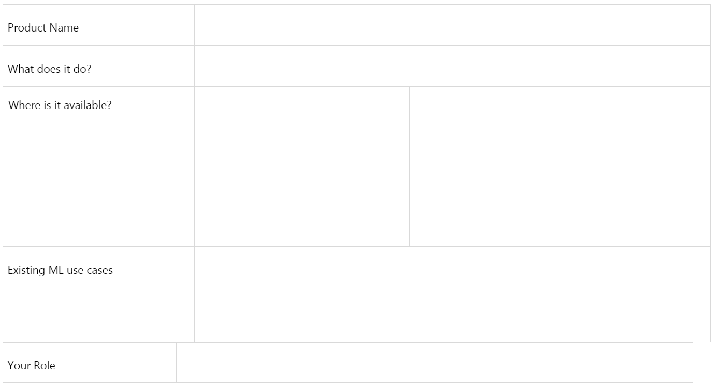
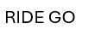

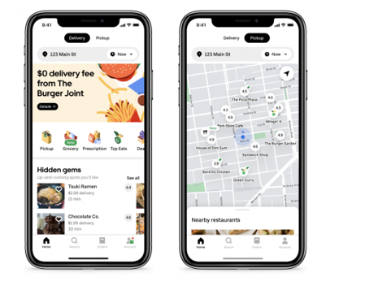
Sprint Planing
RideGo will initially launch in major cities across
Kitchener, Waterloo and Cambridge, with plans to expand to other
Cities and provinces based on user demand and market analysis.
Route Optimization: RideGo will use machine learning to optimize routes for drivers, taking into account real-time traffic conditions, passenger locations, and other factors to minimize travel time and fuel consumption. Dynamic Pricing: The platform will employ ML algorithms to calculate fares based on demand and supply dynamics, ensuring competitive pricing and efficient resource allocation. Driver Allocation: ML algorithms will be used to match passengers with the most suitable driver based on factors such as proximity, driver rating, and vehicle type, providing a personalized and efficient service.
Driver Allocation: ML algorithms will be used to match passengers with the most suitable driver based on factors such as proximity, driver rating, and vehicle type, providing a personalized and efficient service.

Slide 27
Product Name | Ride Go
What does it do? | Ride Go is a ride-sharing platform that connects passengers with drivers for convenient and affordable transportation.
Where is it available? | Ride Go is currently available in major cities across Ontario, CA, including Kitchener, Waterloo, Cambridge, and Toronto, and it plans to expand to other cities.
Existing ML use cases | Route Optimization: Ride Go uses machine learning to optimize routes for drivers, considering traffic conditions, distance, and passenger locations to reduce travel time and fuel consumption. Dynamic Pricing: The platform employs ML algorithms to calculate fares based on demand and supply factors, ensuring fair pricing for passengers and drivers. Driver Allocation: ML algorithms match passengers with the most suitable driver based on proximity, driver rating, and vehicle type, enhancing the overall user experience.
Your Role | Product Manager: Define and prioritize features, oversee product development, and ensure that Ride Go meets the needs of both passengers and drivers. Data Scientist: Develop and refine ML models for route optimization, dynamic pricing, and driver allocation, improving the efficiency and effectiveness of the platform. UX Designer: Design user-friendly interfaces for the Ride Go app, emphasizing ease of use, accessibility, and a seamless booking experience for passengers and drivers. Marketing Manager: Develop marketing campaigns to promote Ride Go, increase user acquisition and retention, and establish Ride Go as a leading ride-sharing platform in India.

Slide 28
Sprint 1
PRODUCT RIDE GO | SPRINT NUMBER 1
GOAL To create an essential search experience for validation via user testing
USER STORIES Create an account. As a user, I want to be able to create an account on the Ride Go app so I can access the ride-sharing platform. Search by price: As a user, I want to be able to search for rides based on price so I can find affordable options for my journey. View property profile: As a user, I want to view the profile of a ride (driver details, vehicle information, ratings, etc.) before booking so I can make an informed decision.

Slide 29
Sprint 2
PRODUCT RIDE GO | SPRINT NUMBER 2
GOAL To enhance the user experience and add features based on user testing feedback.
USER STORIES Filter search results: As a user, I want to be able to filter search results based on different criteria, such as ride type, vehicle model, and driver ratings, so I can find the most suitable ride. Book a ride: As a user, I want to quickly book a ride by selecting the desired ride from the search results and confirming the booking details. View booking history: As a user, I want to be able to view my past ride bookings and details such as date, time, driver, and fare. Provide feedback: As a user, I want to be able to provide feedback on my ride experience and rate the driver so the platform can improve its services.

Slide 30
Sprint 3
PRODUCT RIDE GO | SPRINT NUMBER 3
GOAL To implement payment functionality and improve the overall app performance.
USER STORIES Add payment methods: As a user, I want to be able to add and manage payment methods (credit/debit cards, digital wallets) for seamless transactions. Making a payment: As a user, I want to be able to make payments for ride bookings using the added payment methods. Improve app performance: As a user, I expect the app to be fast and responsive, with minimal loading times and smooth navigation. Enhance security: As a user, I want assurance that my payment information is secure and protected from unauthorized access.

Slide 31
Sprint 4
PRODUCT NAME RIDE GO | SPRINT NUMBER 4
GOAL To expand the app's features and reach a wider audience.
USER STORIES Offer promotions: As a user, I want to receive promotional offers and discounts on ride bookings, so I can save money on my travels. Integrate with social media: As a user, I want to be able to share my ride details and experiences on social media platforms, so I can stay connected with friends and family. Expand to new locations: As a user, I want the app to be available in more cities and countries, so I can use it wherever I travel. Improve accessibility: As a user, I want the app to be accessible to everyone, including those with disabilities, with features like screen readers and voice commands.

Slide 32
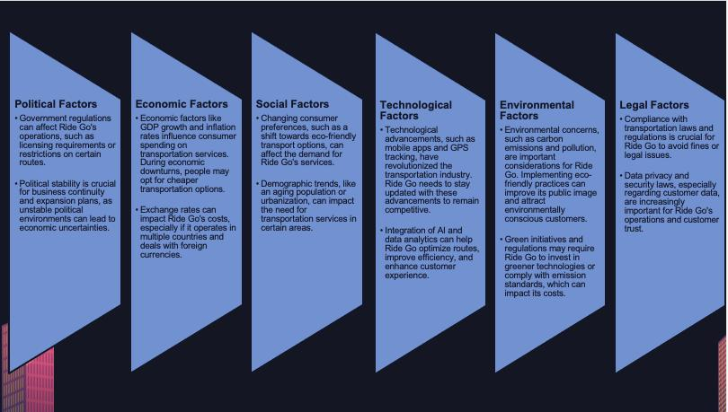

Slide 33
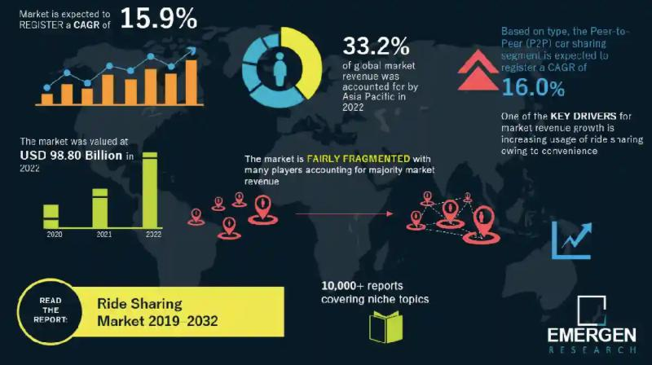

Slide 34
05
Minimum Viable Product

Slide 35
Our Minimum Viable Product (MVP) is focused on fulfilling the core needs of our two main users:
The Everyday Commuter:
Those looking for a cost-effective and convenient way to travel within the city.
Log IN option on multiple platform.
Search for a Ride.
Payment gateways.
In app communication.
The Everyday Rider:
Those who drive daily and want to earn some extra money.
Log IN with specific features and functionality.
Route optimization and transparent communication with passenger.
Minimum requirements for the vehicle & ID verification.
Payment gateways.
Available passengers nearby.

Slide 36
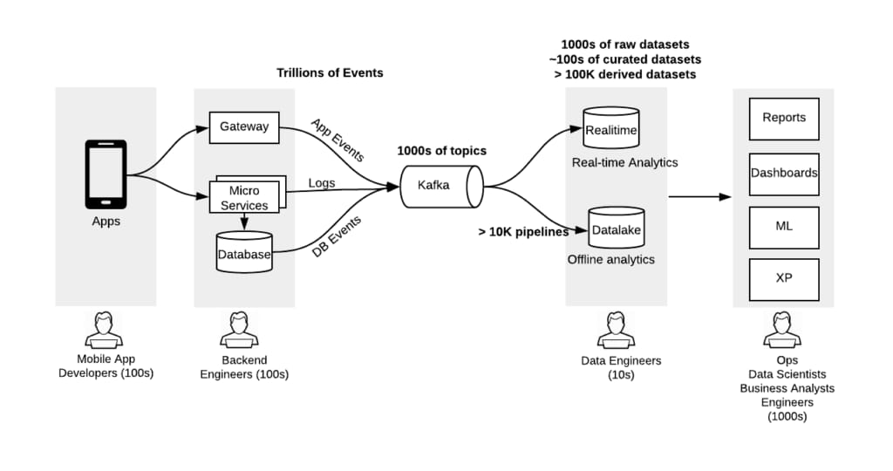
Work Flow:
The picture below shows the high-level flow of data from mobile apps and services to our data warehouse and the ultimate consumption surfaces.
Real-time Data Ingestion
Data Processing
Data Integration
Scalability and Fault Tolerance

Slide 37
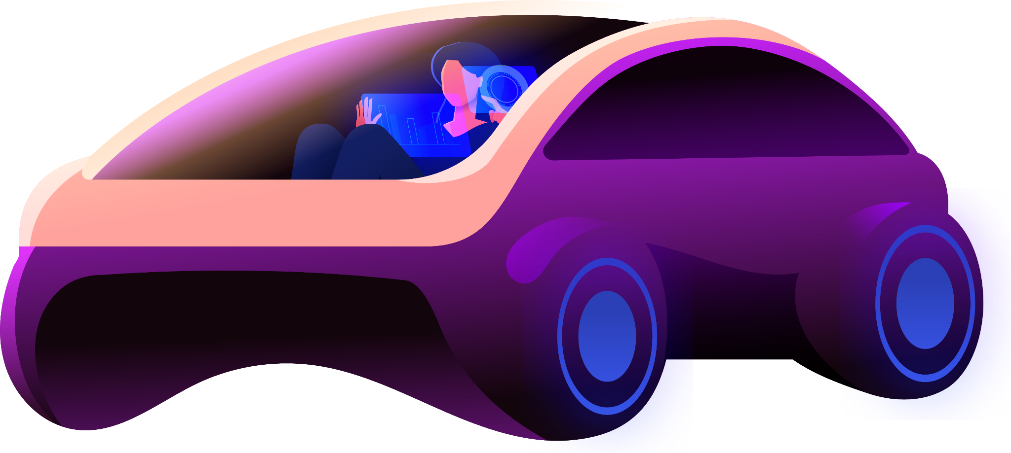
06
AI & ML

Slide 38
Why we need AI or ML?
Generating Traffic to application
Route optimization
An ML model can help identify the potential customers for the rider and eventually generate more traffic on our application.
Machine learning algorithms like A*, depth first search and other searching algorithms can help identify the optimal route for driver.
Targeted marketing
Identifying Raiders with similar drop off location
Machine learning models can also help us target potential customers by methods like behavior analysis and recommendation systems.
E-mail model like K nearest neighborhood and random forest can help us identify riders which potentially have the same root. This can help us and driver to gain potential customers.

Slide 39
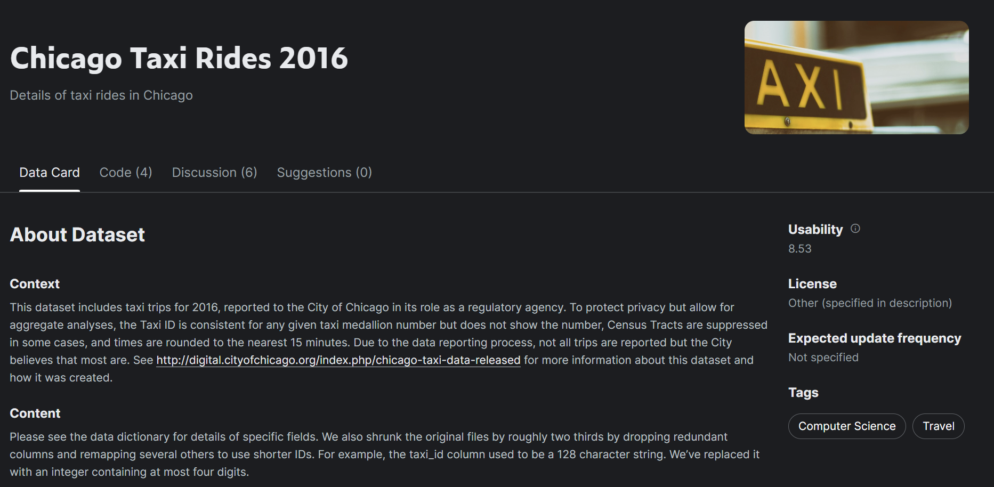

Slide 40
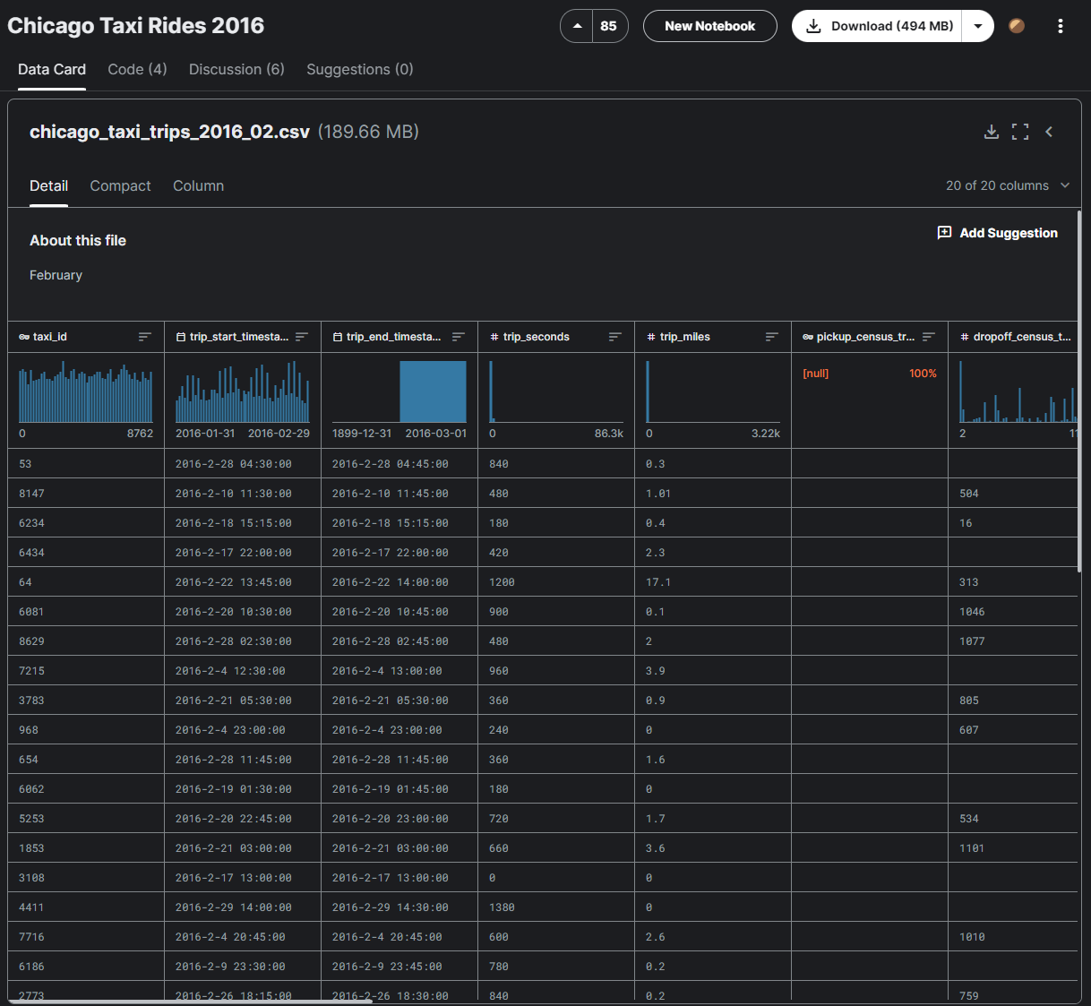

Dataset Link:

Slide 41
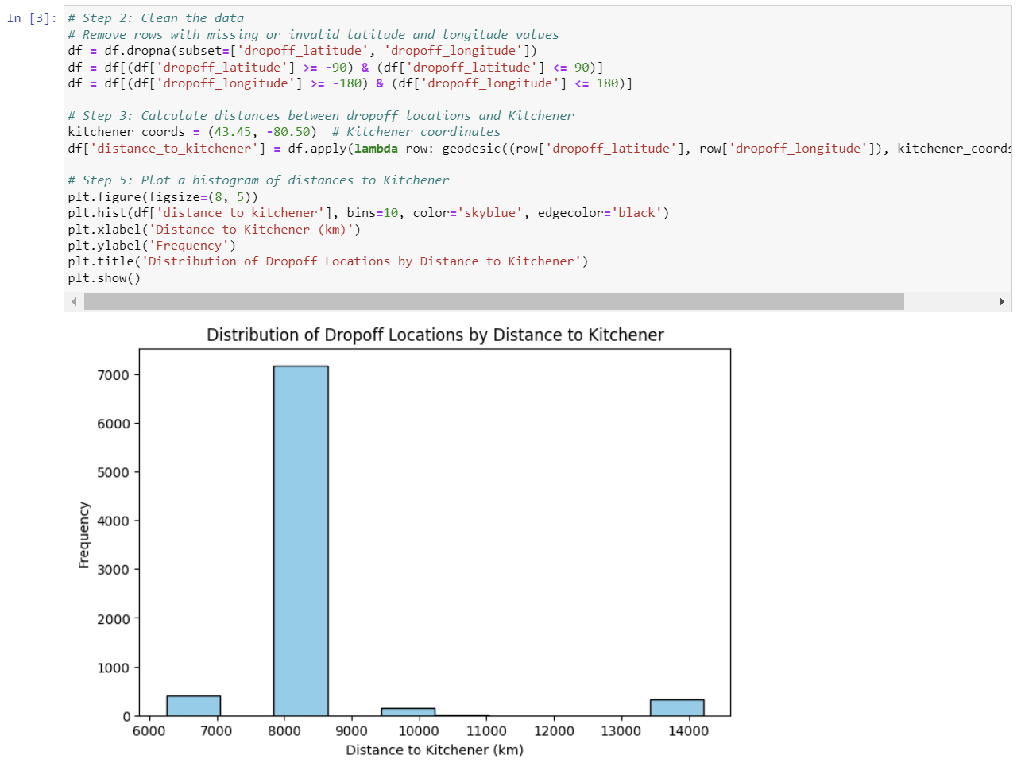
Machine Learning Integration
From the data analysis we done on dataset, graph represents information about the what are the most frequent locations and places individuals tend to go from the Kitchener.
Results shows that most of the Dropoff locations are in the area of 80km from the Kitchener. Also there are some people who travel more far away from Kitchener.

Slide 42
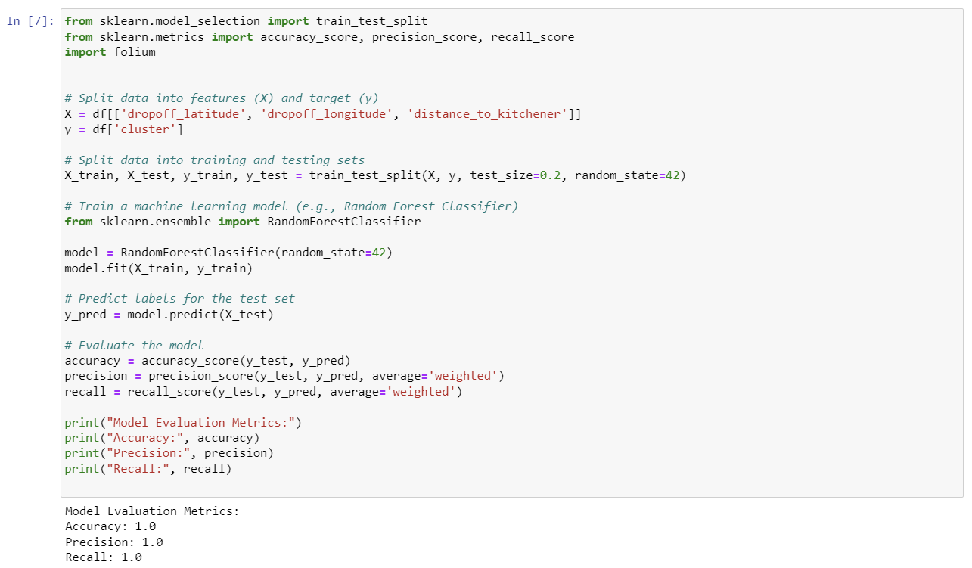
Model Evaluation and Performance
This is the Python formulation of how we are developing our model to target the possible drop off locations from the Kitchener.
Specifically, we are using machine learning approach called random forest classifier to classify identical customers based on similar drop off locations.
Here is the results of our model based on a portion of the dataset and after performing some evalution.

Slide 43
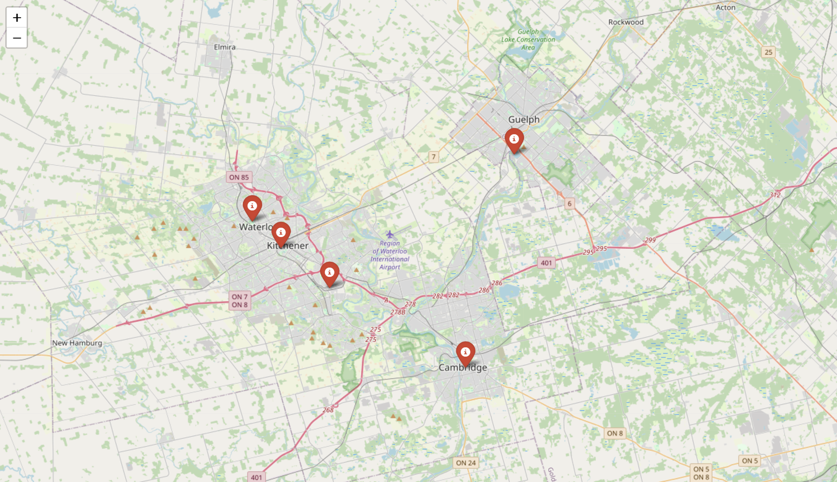
Results of ML model
We can see that model is successfully predicting the potential pathways for a driver which could then lead to route optimization and bringing more new customers to the application platform.

Slide 44
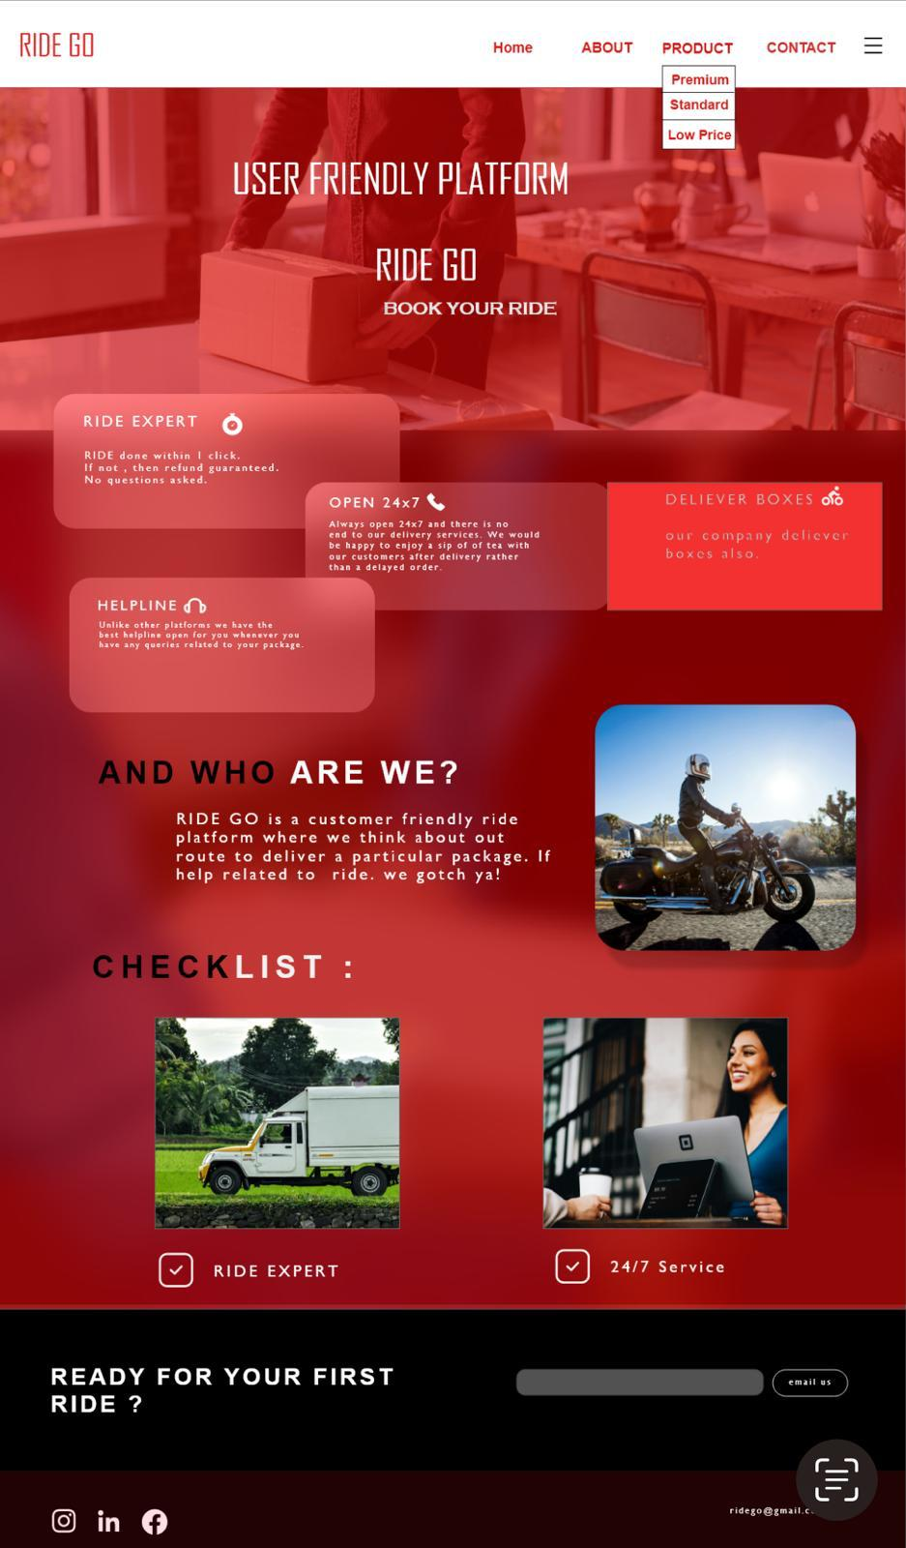

Slide 45


Thanks!
Please keep this slide for attribution

